Slide 1
User/patient driven medical clinic for PLWHIV in Norway
- Shaping tomorrow’s health care services -
Presented by: Maryan Said – User Board Sørlandet Hospital

Slide 2
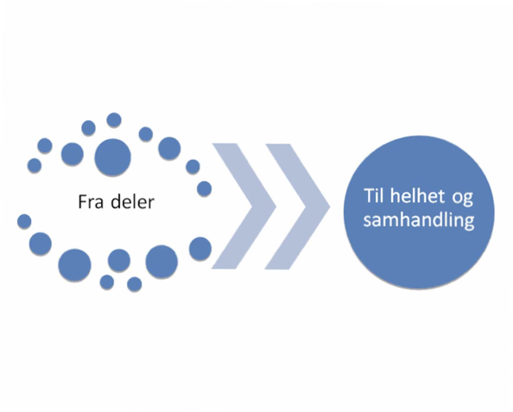

Slide 3
Process
2012 «How would you run the outpatient clinic?»
2012 «Patient order» from the User-Board. Steering document/blueprint.
2012 – today: Medical Department SSHF effectuates
Nye Pluss – National Organization for PLHIV cooperation partner/advisor

Slide 4
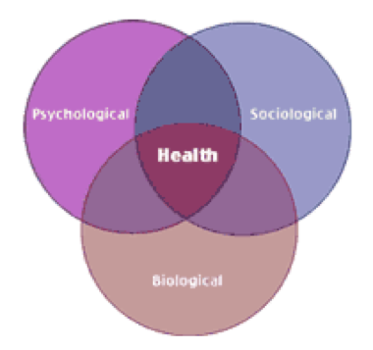
Vision: Promoting optimal health through a holisitc treatment approach and empowering the individual patient.
Holistic treatment modell

Slide 5
Patient order/blueprint
HIV coordinator position (effectuated in February 2013) – Corner stone and link between patient, specialist health services, GP and other parts of the care services
Clear placement of responsibility - Interdiciplinary team meetings + Individual plan
Information flow - Comprehensive checklist (for follow-up of patients)
Learning- and mastering courses (for all)
Systematic use of peer-support in treatment
Communication flow - Secure communication (minjournal) & systematic use of IP
Medical and outpatient (national guidelines)
Psychosocial measures: (climbing, trips, pizza evening etc.)
Management/responsibility (project)
Low threashold testing STI/HIV

Slide 6
HIV Coordinator worktasks
Day-to day contact with patients, infectious disease nurse tasks
QOL measurements (WHO-QOL)
Individual plan
Interdiciplinary team meetings
Checklist
Learning- and mastering courses
Peer-to-peer work.
Secure communicaion via the web.
On going cooperation with the user/patient board
Low threashold STI/HIV testing facility. Well visitedStudy trips, stands, presentationsProject Optimal Patient Pathway++

Slide 7
Checklist
Made by the Patients/users.
Guidance of what to do and how to do it.
Why is the checklist Important
Patient needs to know what to expect
Gives guidance to patients/service users
Adds pressure on health care providers to do their job.
An example of how deeply the patients are involved in shaping of the treatment

Slide 8
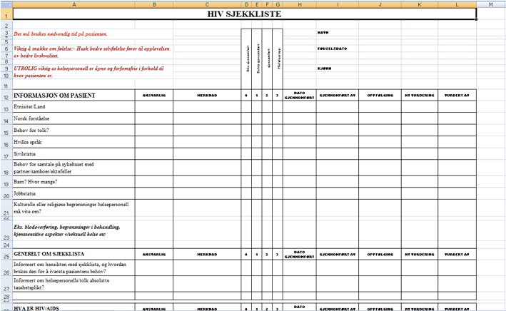

Slide 9
Interdiciplinary team meetings
Meeting place
Discussion
Allocation of responsibility
Cooperation
Time-and resource saving
Minutes with planned timeframe

Slide 10
Learning- and mastering courses
User representative is chairperson
Knowledge gives safeguarding and increased participation
Meeting place (Network).

Slide 11
Results
Before 2012 | 2018: User-driven clinic for PLWHIV
Top-down (Doctor - patient) - Focus mainly on medicine and biomedical markers | HIV Coordinator - Coordinating care, relieving doctor duties, guide in the jungle
Patient not looked at as a coherent whole | Mapping of needs via comprehensive checklist
Nurses - an unused resource | Individual plan for follow up, Learning and mastering courses
No cooperation between different parts of the health and social care services (G.P, Mental health, social services) | Mandatory interdisciplinary team meetings with the patient
No means of facilitating contact between PLWHIV | psychosocial activities
Public awareness and testing services | Low threshold HIV/STD testing

Slide 12
Success criteria
Anchoring in the hospital management necessary.
Driving forces at department level necessary.
Necessary resources (personnel, money, time).
TRUE user involvement with binding agreement on what a user driven clinic is/should be.
Consensus on goals and routines for reporting, deadlines, responsibility.

Slide 13
Challenges
Stigma
Difficulties in the recruitment and representation of service users
Difficulties in the recruitment of service users into the Learning and Mastering course
Funding insecurities.
Language barrier and lack of experience with managerial work

Slide 14
True user involvement
A formalised user forum consisting of patients are given formalized decision making power at an institutional level.
True power and influence on all levels regarding diagnostication, prevention and treatment.
Optimal follow-up. Avoid «patient ping-pong». Safeguarding
The patient group: Is the premise provider for the services offered by the specialiced health ceare services, based on individual needs
Is the goal equality?
User governance as a means of getting there?

Slide 15
Acknowledgements
Dr. Ole Rysstad - Head of the Medical Department at Sørlandet Hopital
Solveig Songe and Kristin Baardsen - HIV-Coordinators at Sørlandet Hospital
The User’s Board at Sørlandet Hospital
Nye Pluss – The Norwegian Organization for PLWHIV
Birgit Lie - SSHF
Vegard Skogen - UNN
Countless anonymous PLWHIV
Rigmor Berg – The Norwegian Institute of public health

